Slide 1
Natural Language Processing DSECL ZG565
Prof.Vijayalakshmi
BITS-Pilani

Slide 2
Session 1
Date – 30th August 2020
Time – 9 am to 11 am
These slides are prepared by the instructor, with grateful acknowledgement of James Allen and many others who made their course materials freely available online.

Slide 3
Session Content
Objective of course
Evaluation Plan
What is Natural Language Processing?
Why NLP?
Applications of Natural Language Processing
What will we learn in this course?
Natural Language Understanding
Evaluation of NLP system

Slide 4
Objective of course
To learn the fundamental concepts and techniques of natural language processing (NLP)
To learn computational properties of natural languages and the commonly used algorithms for processing linguistic information
To apply NLP techniques in state of art applications
To learn implementation of NLP algorithms and techniques
30 August 2020

Slide 5
Books
Text books and Reference book(s)
T1 | Speech and Language processing: An introduction to Natural Language Processing, Computational Linguistics and speech Recognition by Daniel Jurafsky and James H. Martin[3rd edition]
T2 | Natural language understanding[2nd edition] by James Allen
R1 | Handbook of Natural Language Processing, Second Edition—NitinIndurkhya, Fred J. Damerau, Fred J. Damerau
R2 | Natural Language Processing with Python by Steven Bird, Ewan Klein, Edward Lopper
30 August 2020

Slide 6
Evaluation Plan
Name | Type | Duration | Weight
Assignment-I | Take Home |  | 15%
Quiz | Online |  | 5%
Mid-Semester Exam (after 7 sessions) | Closed Book | 1.5 Hrs | 30%
Comprehensive Exam | Open Book | 2.5 Hrs | 50%
30 August 2020

Slide 7
What is Natural Language Processing?
Natural Language Processing
Process information contained in natural language text.
Also known as Computational Linguistics (CL), Human Language Technology (HLT), Natural Language Engineering (NLE)

Slide 8
What is it..
Analyze, understand and generate human languages just like humans do.
Applying computational techniques to language domain..
To explain linguistic theories, to use the theories to build systems that can be of social use..
Started off as a branch of Artificial Intelligence..
Borrows from Linguistics, Psycholinguistics, Cognitive Science & Statistics.
Make computers learn our language rather than we learn theirs.

Slide 9

Natural Language processing
Increase of online data
Process unstructured data and extract meaningful information
Challenges
Solution-Natural langue processing

Slide 10




Application of NLP

Slide 11
History of NLP
1950-Alan turing published paper
1957-Chomsky published his book, Syntactic Structures
1958-LISP
1964-ELIZA
1966-AI,NLP ,Machine transalation
1980-IBM
1980-till date-Machine language

Slide 12
Example
Dave: Open the pod bay doors, HAL.
HAL: I am sorry, Dave. I am afraid I can’t do that.
Dave: What’s the problem.
HAL: I think you know what the problem is just as well as I do.
Dave: I don’t know what you’re talking about.
HAL: I know that you and Frank were planning to disconnect
me, and I’m afraid that’s something I cannot allow to happen.
General speech and language understanding and generation capabilities
Politeness: emotional intelligence
Self-awareness: a model of self, including goals and plans
Belief ascription: modeling others; reasoning about their
goals and plans

Slide 13
Contd..
Hal: I can tell from the tone of your voice, Dave, that you’re upset.
Why don’t you take a stress pill and get some rest.
[Dave has just drawn another sketch of Dr. Hunter].
HAL: Can you hold it a bit closer?
[Dave does so].
HAL: That’s Dr. Hunter, isn’t it?
Dave: Yes.
Recognition of emotion from speech
Vision capability including visual recognition of emotions and faces
Also: situational ambiguity

Slide 14
Contd..
To attain the levels of performance we attribute to HAL, we need to be able to define, model, acquire and
manipulate
Knowledge of the world and of agents in it,
Text meaning,
Intention

Slide 15
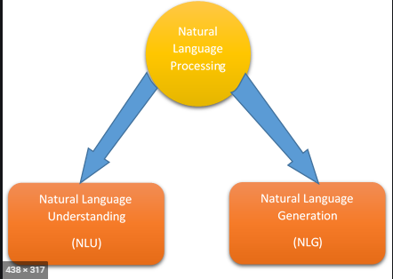
Main components of NLP

Slide 16
Natural language understanding
allows users to interact more naturally with the computer.
Different levels of analysis
Morphological Analysis
Syntactic analysis
Semantic analysis
Discourse analysis

Slide 17
Natural language generation
NLG will decide how to respond by
Deep Planning
Syntactic generation

Slide 18
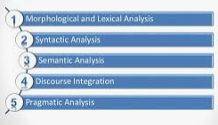
Steps used for NLU

Slide 19
Morphology analysis
Morphology is the arrangement and relationships of the smallest meaningful units in a language.
Eg:
Firehouse
Doghouse
runs

Slide 20
Lexical analysis
Lexicon of a language means the collection of words and phrases in a language.
Lexical analysis is dividing the whole chunk of text into paragraphs, sentences, and words.

Slide 21
Syntactic analysis
Syntax analysis checks the text for meaningfulness comparing to the rules of formal
Eg:
“the girl go to the school “
Agra goes to the Poonam

Slide 22
Semantic analysis
It draws the exact meaning or the dictionary meaning from the text. The text is checked for meaningfulness.
Eg:Colourless blue idea

Slide 23
Discourse integeration
The meaning of any sentence depends upon the meaning of the sentence just before it
Eg:
she wanted it

Slide 24
Pragmatic analysis
how sentences are used in different situations how use affects the interpretation of sentence
Eg:
Close the window
She cuts banana with a pen

Slide 25
Natural Language Generation
producing text from computer data
Steps
discourse planning
Surface realizer
Lexical selection

Slide 26
Why NLP is hard
Ambiguity
Eg:
Teacher strikes idle kids.
Sarah gave a bath to her dog wearing a pink t-shirt.
RBI raises interest rates or RBI raises, interest rates.

Slide 27
Ambiguities at all level
Structural Ambiguities
Namrata thinks she understands me.
She thinks Namrata understands me.
Visiting relatives can be nuisance. (two meanings)
Lexical Ambiguities:
I saw bats

Slide 28
Contd..
Non Standard english
don’t follow any rules
Eg: gm, gudnit etc.
Segmentation issues
Eg The old city-bus stop
Idioms
Eg:
dark horse
lose face

Slide 29
World knowledge
Eg:
Mary and Sue are sisters.
Mary and Sue are mothers.
Tricky entity names
Let it be was recorded.
Where is a bug’s life playing?

Slide 30
Some of the tasks in NLP
Sentence segmentation
It breaks the paragraph into separate sentences.
Eg:Independence Day is one of the important festivals for every Indian citizen. It is celebrated on the 15th of August each year ever since India got independence from the British rule. The day celebrates independence in the true sense.
"Independence Day is one of the important festivals for every Indian citizen."
"It is celebrated on the 15th of August each year ever since India got independence from the British rule."
"This day celebrates independence in the true sense."

Slide 31
Contd..
Tokeniztion
splits longer strings of text into smaller pieces, or tokens.
Eg:JavaTpoint offers Corporate Training, Summer Training, Online Training, and Winter Training.
"JavaTpoint", "offers", "Corporate", "Training", "Summer", "Training", "Online", "Training", "and", "Winter", "Training", "."
Lemmatization
capture canonical forms based on a word's lemma.
Eg:better → good

Slide 32
Contd..
Stemming
process of eliminating affixes (suffixed, prefixes, infixes, circumfixes) from a word in order to obtain a word stem.
eg. running → run
Stop Words
contribute little to overall meaning
Eg:He is a good boy.

Slide 33
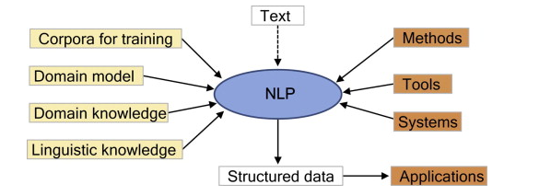
Schematic representation NLP

Slide 34
What We will learn in this Course
Introduction to Natural Language Understanding
N-gram Language Models
Hidden Markov Models
Part-of-Speech Tagging
Grammars and Parsing
Statistical Constituency Parsing
Word sense and word net
Dependency Parsing
Statistical Machine translation
Semantic web ontology
Question Answering
Dialogue Systems and Chatbots
Sentiment analysis

Slide 35
N-gram language models
An N-gram model is one type of a Language Model (LM), which is about finding the probability distribution over word sequences
E.g:
There was heavy rain
There was heavy flood.

Slide 36
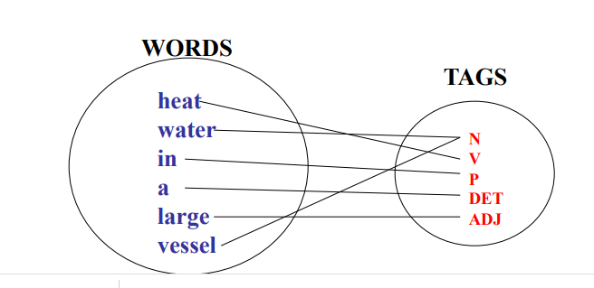
POS tagging
The process of assigning a part-of-speech to each word in a sentence

Slide 37
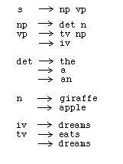
Grammars and parsing
list of rules that define the set of all well-formed sentences in a language

Slide 38
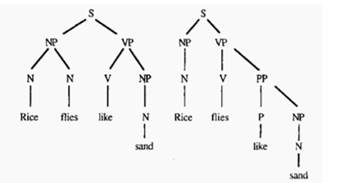
Parsing
Find that how all the words in the sentence are related to each other

Slide 39
Word sense disambiguation
the task of determining which sense of a word is being used in a particular context.
Eg:
“The bank will not be accepting cash on Saturdays. ”
“The river overflowed the bank

Slide 40

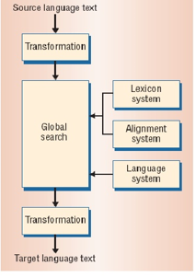
Machine translation

Slide 41
Types
Rule based
Stastical based

Slide 42
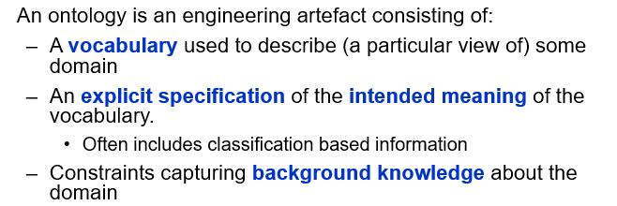
Semantic web ontology

Slide 43
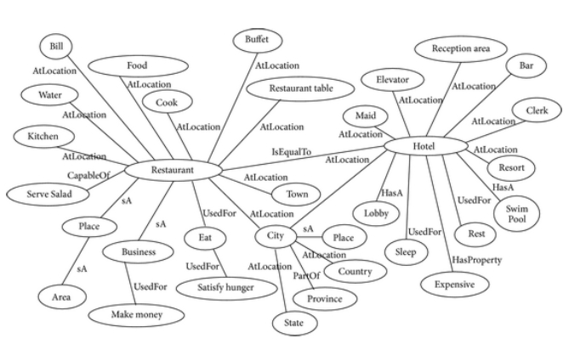
Sample Ontology

Slide 44
Semantic web
Extends the current web to web of data
Publish the data to make it known on the web
link to various URL from other sources of data

Slide 45
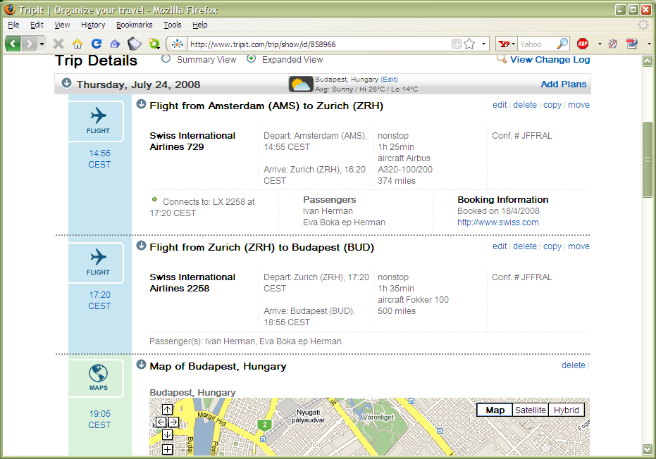
A “mashup” example:

Slide 46
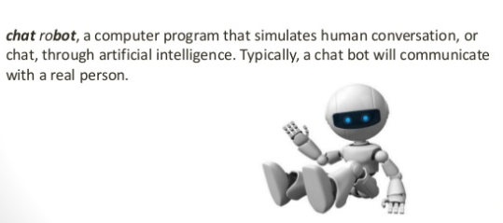
Chat bot

Slide 47
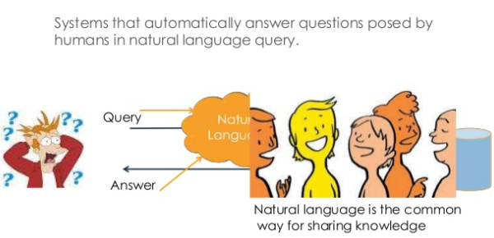
Question and answering sysetms

Slide 48
Evaluating Language Understanding Systems
What metrics to use?
How to deal with complex outputs like translations?
Are the human judgments measuring something real? reliable?
Is the sample of texts sufﬁciently representative?
How reliable or certain are the results?

Slide 49
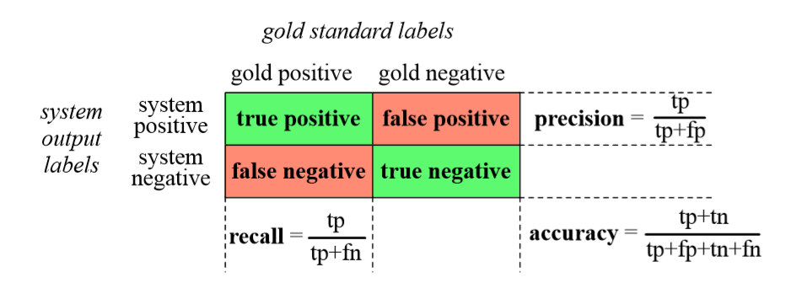
Contingency Table

Slide 50
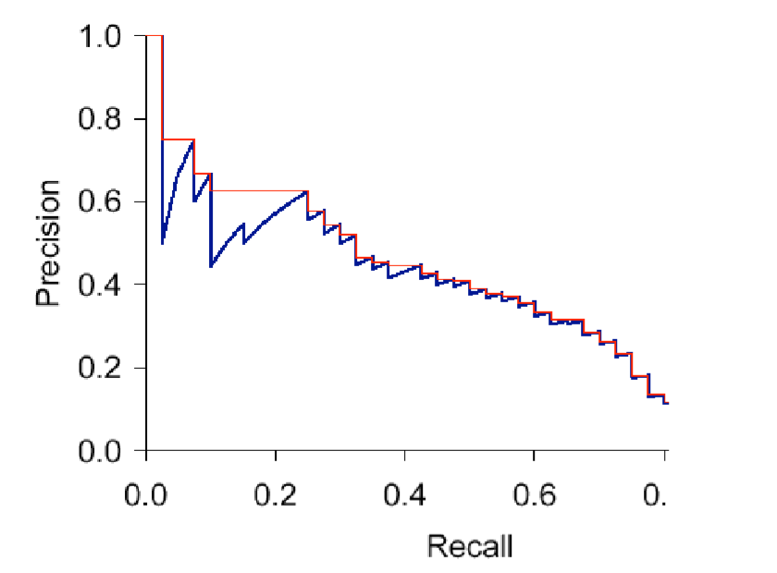
Tradeoff between Precision and Recall

Slide 51
Good References
https://emerj.com/partner-content/nlp-current-applications-and-future-possibilities/

Slide 52
Thank You… ☺
Q&A
Suggestions / Feedback

